Slide 1
Opening business place in Los Angeles
Capstone Project - The Battle of Neighborhoods

Slide 2
Introduction: Business Problem
The aim of this project is to find a safe and secure location for opening of commercial establishments in Los Angeles, USA. Specifically, this report will be targeted to stakeholders interested in opening any business place like Grocery Store in Los Angeles, USA.
The first task would be to choose the safest borough by analysing crime data for opening a grocery store and short listing a neighbourhood, where grocery stores are not amongst the most commom venues, and yet as close to the city as possible.
We will make use of our data science tools to analyse data and focus on the safest borough and explore its neighborhoods and the 10 most common venues in each neighborhood so that the best neighborhood where grocery store is not amongst the most common venue can be selected.

Slide 3
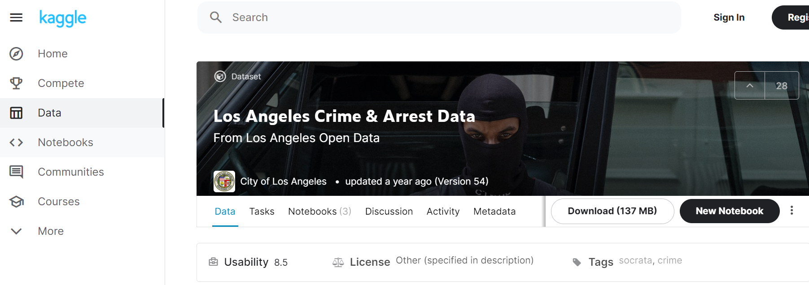
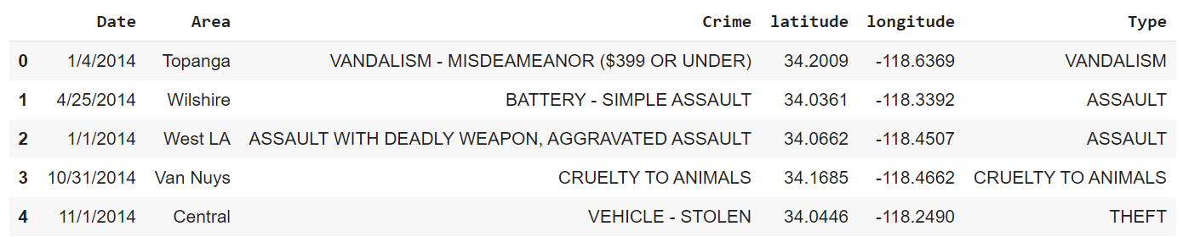
Data acquisition and cleaning
Using a real world data set from Kaggle containing the Los Angeles Crimes from 2010 to 2019
Since the datasets are so huge >750MB, reduced version has been uploaded into GitHub with selected key columns with range 2014 to 2015
Date
Area
Crime
latitude--> it is sperated from Location
longitude -->it is seperated from Location
Type--> crime type, aggregated type of Crime since there are more than 200 sbugroups

Slide 4
Methodology Categorized the methodologysection into two parts:
Exploratory Data Analysis: Visualise the crime repots in different Los Angeles boroughs to idenity the safest borough and normalise the neighborhoods of that borough. We will Use the resulting data and find 10 most common venues in each neighborhood.
Modelling: To help stakeholders choose the right neighborhood within a borough we will be clustering similar neighborhoods using K - means clustering which is a form of unsupervised machine learning algorithm that clusters data based on predefined cluster size. We will use K-Means clustering to address this problem so as to group data based on existing venues which will help in the decision making process.

Slide 5
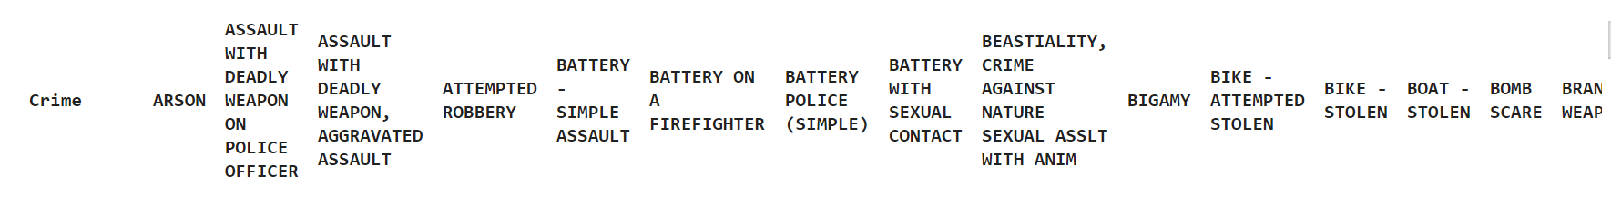
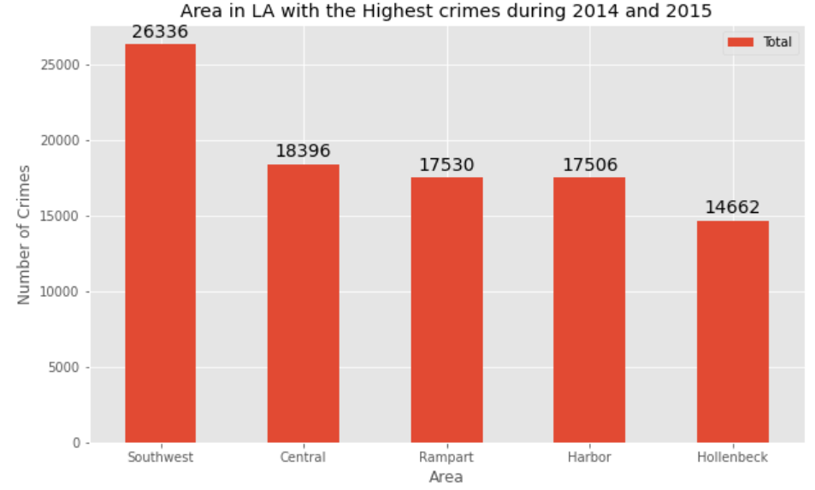
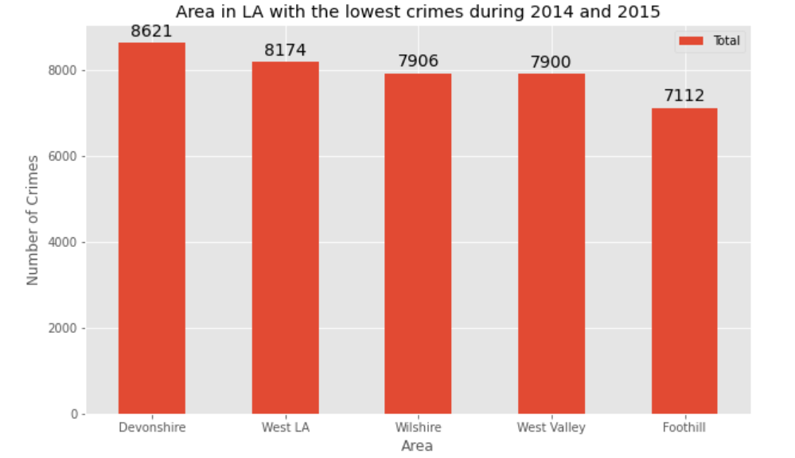
Exploratory Data Analysis
Crime is too details, let us use Crime Type instead
Sorting the data by crimes per neighborhood and plotting Five Neighborhoods with highest crime

Slide 6
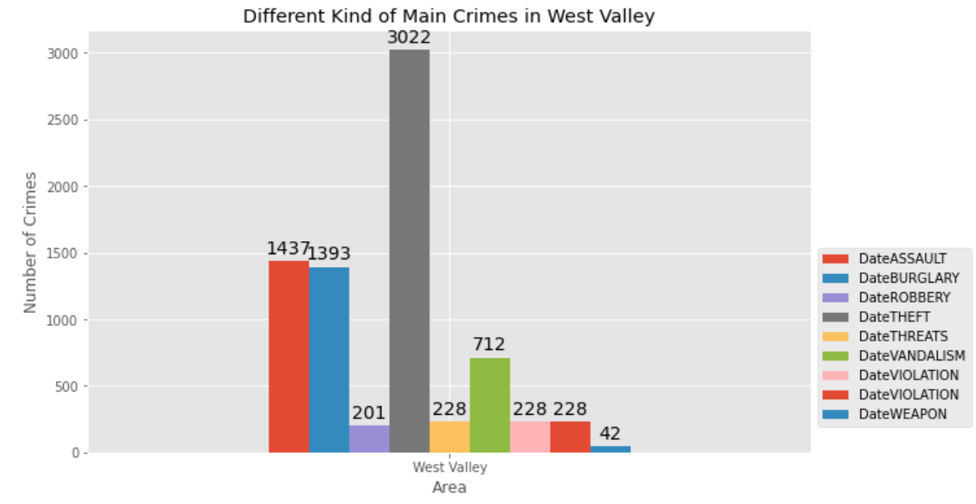
Further Analsysis based on common sense
Based on exploratory data analysis it is clear that Foothill has the lowest crimes
Since Foothill has very little number of neighborhoods (highway and less populations) and opening a commercial establishment would not be viable, we can choose the next borough with lowest crime which is West Valley.

Slide 7
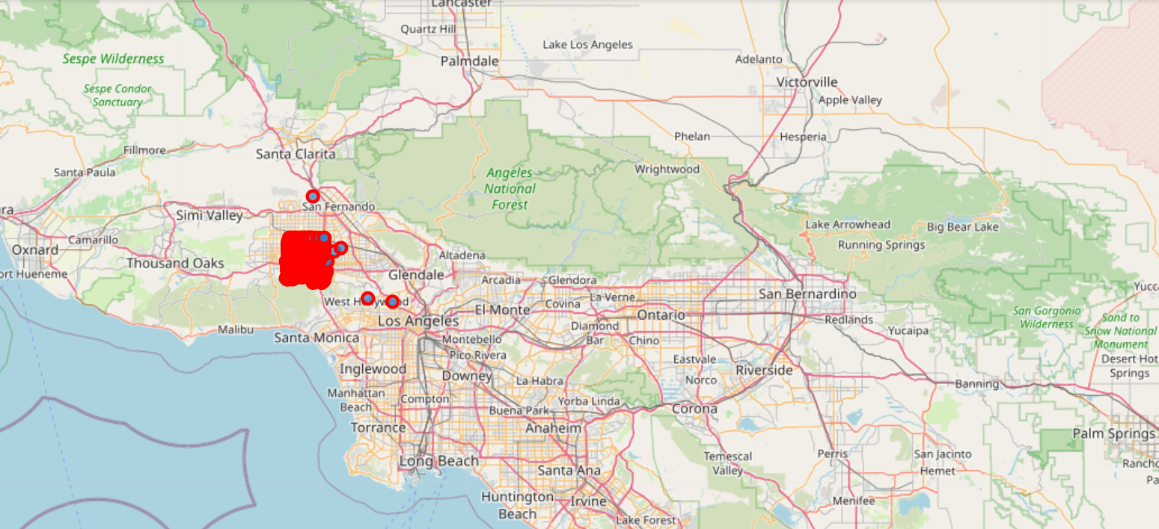
Using Folium to plot West Valley Area

Slide 8
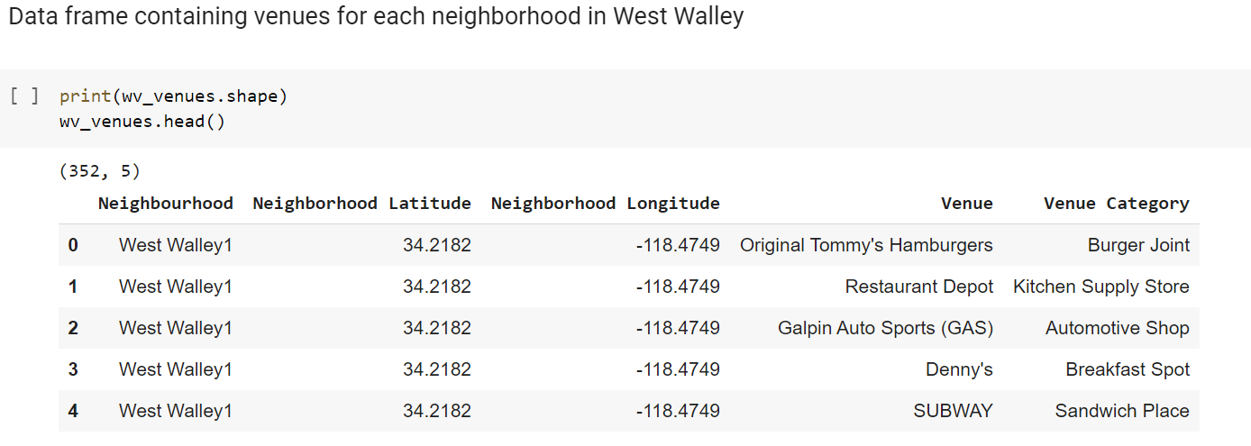
Get most common venues with Foursquare

Slide 9
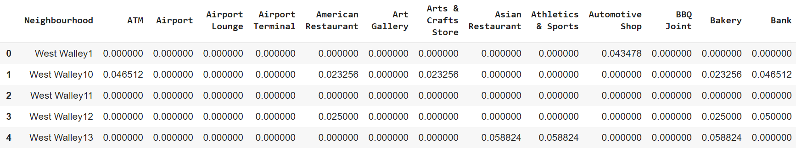
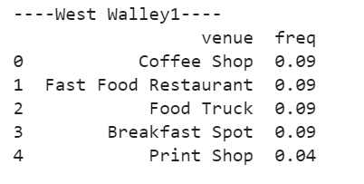
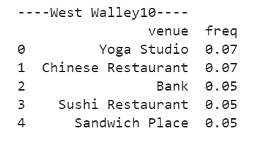
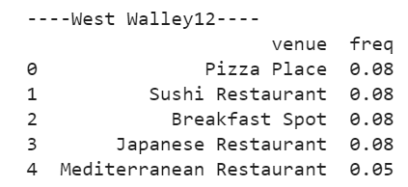
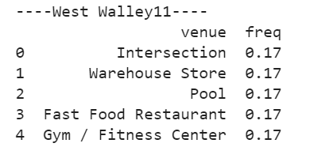
Cluster - Data Manupulation
One Hot Encoding to Analyze Each Neighborhood
Top 5 most common venues across neighborhoods
create the new dataframe and display the top 10 venues for each neighborhoods
....

Slide 10
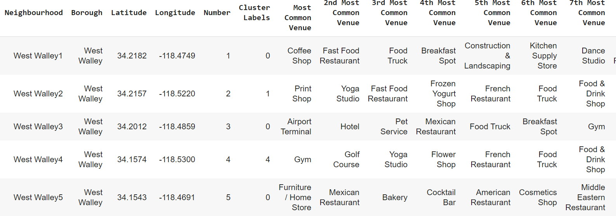
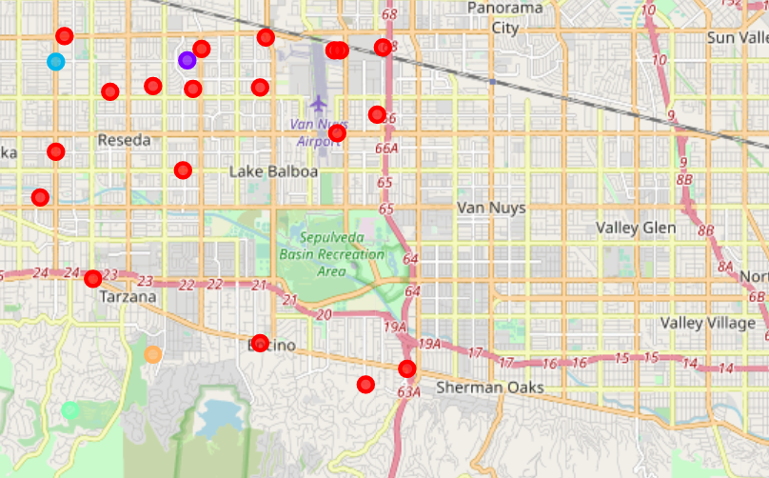
Cluster - Data Modelling
KNN, K=5

Slide 11
Results and Discussion
The objective of the business problem was to help stakeholders identify one of the safest area in Los Angels, and an appropriate neighborhood within the borough to set up a commercial establishment especially a Grocery store. This has been achieved by first making use of LA crime data to identify a safe borugh with considerable number of neighborhood for any business to be viable. After selecting the area it was imperative to choose the right neighborhood where grocery shops were not among venues in a close proximity to each other. We achieved this by grouping the neighborhoods into clusters to assist the stakeholders by providing them with relavent data about venues and safety of a given neighborhood.

Slide 12
Conclusion
We have explored the crime data to understand different types of crimes in all neighborhoods of Los Angles and later categorized them into different boroughs, this helped us group the neighborhoods into boroughs and choose the safest borough first. Once we confirmed the borough the number of neighborhoods for consideration also comes down, we further shortlist the neighborhoods based on the common venues, to choose a neighborhood which best suits the business problem.

